Slide 1






Adichunchanagiri Institute of Technology, Chikkamagaluru
Department of Computer Science and Engineering
Internship Project seminar on
“USAGE OF GITHUB FOR DEVOPS”
CARRIED AT
Mrs. Keerthishree B.T,
Tech.
Mr.Amith , B.E..,
DEVOPS ENGINEER , FUNDAMENTALS
PRESENTED BY AMULYA N RAJ (4AI19CS009)
1
Date : 22nd Feb 2023
8th Semester, Department of CS&E

Slide 2


The collection and mining of GitHub data , aiming to understand GitHub user behaviour.
Creation of repositories with respect to various dimensions. Only one person from authors is contributing to the repositories.
GitHub is a code hosting platform for version control and collaboration. It will let the users to work togeather on projects from anywhere.
GitHub makes it easy for developers to share code files and collaborate with fello developers on open- source projects.
GitHub serves as a social networking site where developers can openly network, collaborate, and pitch their work.
DEPARTMENT OF COMPUTER SCIENCE AND ENGINEERING, A.I.T., CHIKKAMAGALURU.
25 May 2023

Slide 3


CONTENTS
Introduction
Motivation
Problem Statement
Objectives
Scope
Implementation
Result and Analysis
Conclusion and Future Enhancements
References
DEPARTMENT OF COMPUTER SCIENCE AND ENGINEERING, A.I.T., CHIKKAMAGALURU.
25 May 2023

Slide 4
INTRODUCTION
GitHub is a platform for the creation of account to upload files and create coding projects. But the real work of GitHub happens when users begin to collaborate.
In GitHub anyone can code independently, teams of people build most development projects. Sometimes these teams are all in one place at time, but more often they work asynchronusly.
The collaboration of projects with distributed teams may be difficult but GitHub makes this process much simpler. It also tracks changes and go back to previous versions of a projects.
Git is an open-source and most widely used version control system in software development, and GitHub leverages this technology for it’s service.
25 May 2023
DEPARTMENT OF COMPUTER SCIENCE AND ENGINEERING, A.I.T., CHIKKAMAGALURU.
13 March 2023

Slide 5


GitHub is used to provide an easy-to-use interface for version control that allows all the activities to be recorded.
GitHub can revisit past versions so that it provides information about who made each contribution to the project.
GitHub will also provides many options for automating repeated project management tasks.
GitHub provides real-world experience with free access to various developer tools from GitHub’s partners.
Git is having branching capabilities. Unlike centralized version control systems, Git branches are cheap and easy to merge.
25 May 2023
DEPARTMENT OF COMPUTER SCIENCE AND ENGINEERING, A.I.T., CHIKKAMAGALURU.
30₁₃N_{M}ov_{a}e_{r}m_{ch}be₂r₀₂0₃21

Slide 6




The main aim of the project is to create public and private files and to upload file in repository of GitHub also edit the content of the files, Renaming the files and to provide multiple-user access of the files on the same project.
Input: The files, documents and branch given as an input by the user.
Processing: It focuses on branching and makes it possible for teams experiment freely. The public and private files will be created or existing projects and files will be uploaded to repository and commit.
Output: Created or the uploaded files will be documented in the repositories of GitHub.
25 May 2023
DEPARTMENT OF COMPUTER SCIENCE AND ENGINEERING, A.I.T., CHIKKAMAGALURU.
13 March 2023

Slide 7
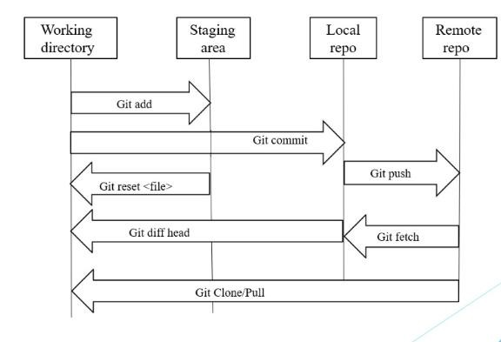
SYSTEM ARCHITECTURE
Figure: System architecture of usage of GitHub in uploading files
25 May 2023
DEPARTMENT OF COMPUTER SCIENCE AND ENGINEERING, A.I.T., CHIKKAMAGALURU.
13 March 2023

Slide 8

To provide robust version control features that allows the developers to track changes made in their over time.
To allow the developers to work togeather on the same codebase providing tools for code review.
To provide tools for managing software devolopment projects including issue tracking.
To integrates with a wide range of other tools and services, making it easy to automate workflow.
25 May 2023
13 March 2023
DEPARTMENT OF COMPUTER SCIENCE AND ENGINEERING, A.I.T., CHIKKAMAGALURU.
30 November 2021

Slide 9
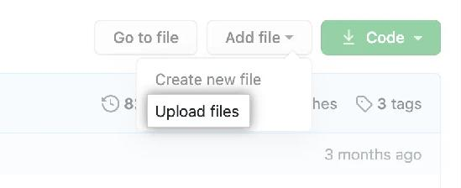
IMPLEMENTATION
On GitHub.com, navigate to the main page of the repository.
In your repository, browse to the folder where you want to create a file.
Above the list of files, using the Add file drop-down, click Create new file. "Create new file" in the "Add file" dropdown
25 May 2023
DEPARTMENT OF COMPUTER SCIENCE AND ENGINEERING, A.I.T., CHIKKAMAGALURU.
13 March 2023

Slide 10

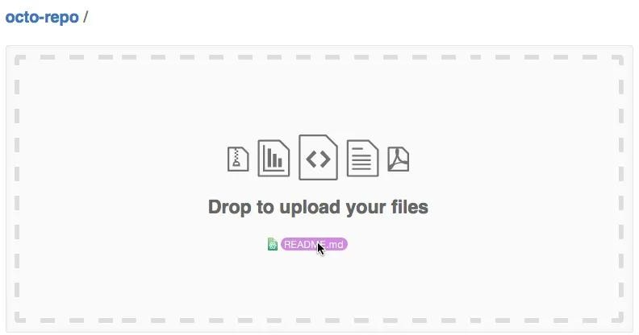
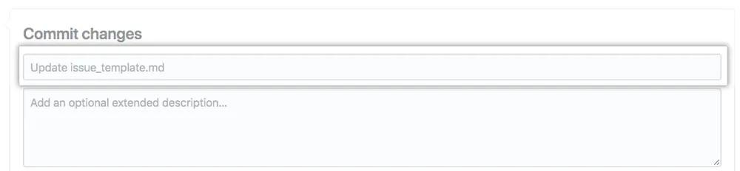
IMPLEMENTATION cont..
Above the list of files, using the Add file drop-down, click Create new file. "Create new file" in the "Add file" dropdown
At the bottom of the page, type a short, meaningful commit message that describes the change you made to the file. You can attribute the commit to more than one author in the commit message. For more information, see "Creating a commit with multiple authors."
25 May 2023
DEPARTMENT OF COMPUTER SCIENCE AND ENGINEERING, A.I.T., CHIKKAMAGALURU.
13 March 2023

Slide 11

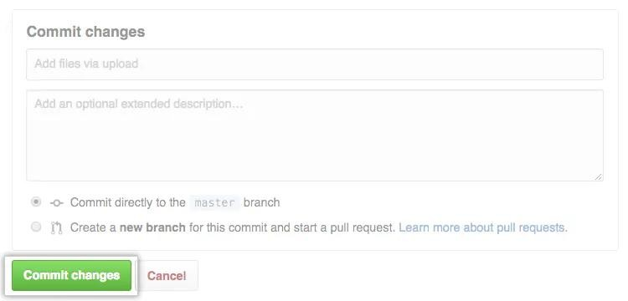

IMPLEMENTATION cont..
Click Commit changes.
25 May 2023
DEPARTMENT OF COMPUTER SCIENCE AND ENGINEERING, A.I.T., CHIKKAMAGALURU.
13 March 2023

Slide 12

IMPLEMENTATION cont..
Simple files can be uploaded by using drag and drop method.
Error in uploading complex files and Projects.
Alternative method for uploading complex files using Command lines.
25 May 2023
DEPARTMENT OF COMPUTER SCIENCE AND ENGINEERING, A.I.T., CHIKKAMAGALURU.
13 March 2023

Slide 13













IMPLEMENTATION cont..,
ADDING FILE TO REPOSITORY USING THE COMMAND LINE
On your computer, move the file you'd like to upload to GitHub into the local directory that was created when you cloned the repository.
Open Git Bash.
Change the current working directory to your local repository.
Stage the file for commit to your local repository.
Commit the file that you've staged in your local repository.
25 May 2023
13 March 2023

Slide 14

IMPLEMENTATION cont.,
Push the changes in your local repository to GitHub.com.
$ git push origin YOUR_BRANCH
# Pushes the changes in your local repository up to the remote repository you specified as the origin
25 May 2023
13 March 2023

Slide 15
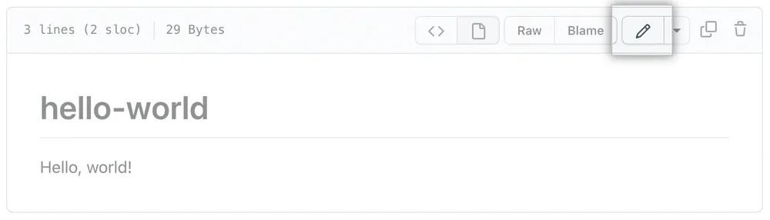
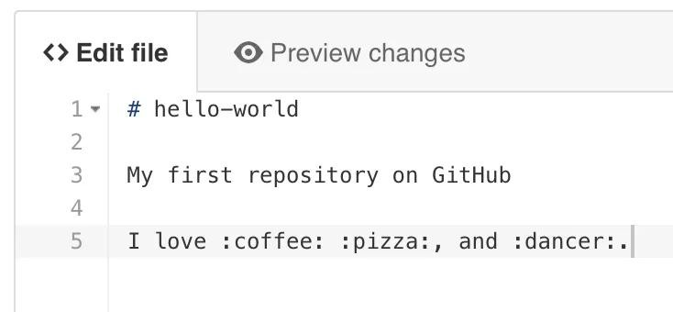

IMPLEMENTATION cont.,
EDITING FILES CONTENT IN YOUR REPOSITORY
In your repository, browse to the file you want to edit.
In the upper right corner of the file view, click to open the file editor.
On the Edit file tab, make any changes you need to the file.
25 May 2023
DEPARTMENT OF COMPUTER SCIENCE AND ENGINEERING, A.I.T., CHIKKAMAGALURU.
13 March 2023

Slide 16

IMPLEMENTATION cont.,
At the bottom of the page, type a short, meaningful commit message that describes the change you made to the file. You can attribute the commit to more than one author in the commit message. For more information, see "Creating a commit with multiple authors."
25 May 2023
DEPARTMENT OF COMPUTER SCIENCE AND ENGINEERING, A.I.T., CHIKKAMAGALURU.
13 March 2023

Slide 17
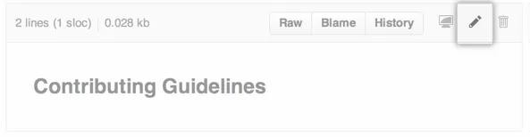
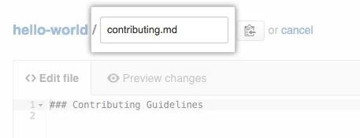

IMPLEMENTATION cont.,
RENAMING A FILE IN GITHUB
In your repository, browse to the file you want to rename.
In the upper right corner of the file view, click to open the file editor.
In the filename field, change the name of the file to the new filename you want. You can also update the contents of your file at the same time.
25 May 2023
DEPARTMENT OF COMPUTER SCIENCE AND ENGINEERING, A.I.T., CHIKKAMAGALURU.
13 March 2023

Slide 18
IMPLEMENTATION cont.,
At the bottom of the page, type a short, meaningful commit message that describes the change you made to the file. You can attribute the commit to more than one author in the commit message. For more information, see "Creating a commit with multiple authors."
25 May 2023
DEPARTMENT OF COMPUTER SCIENCE AND ENGINEERING, A.I.T., CHIKKAMAGALURU.
13 March 2023

Slide 19
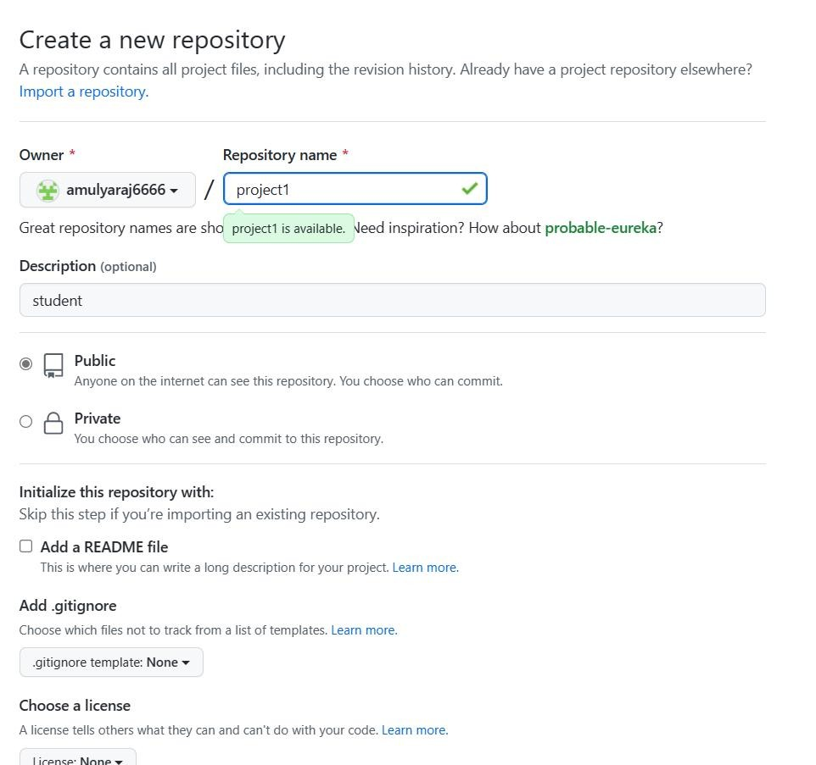
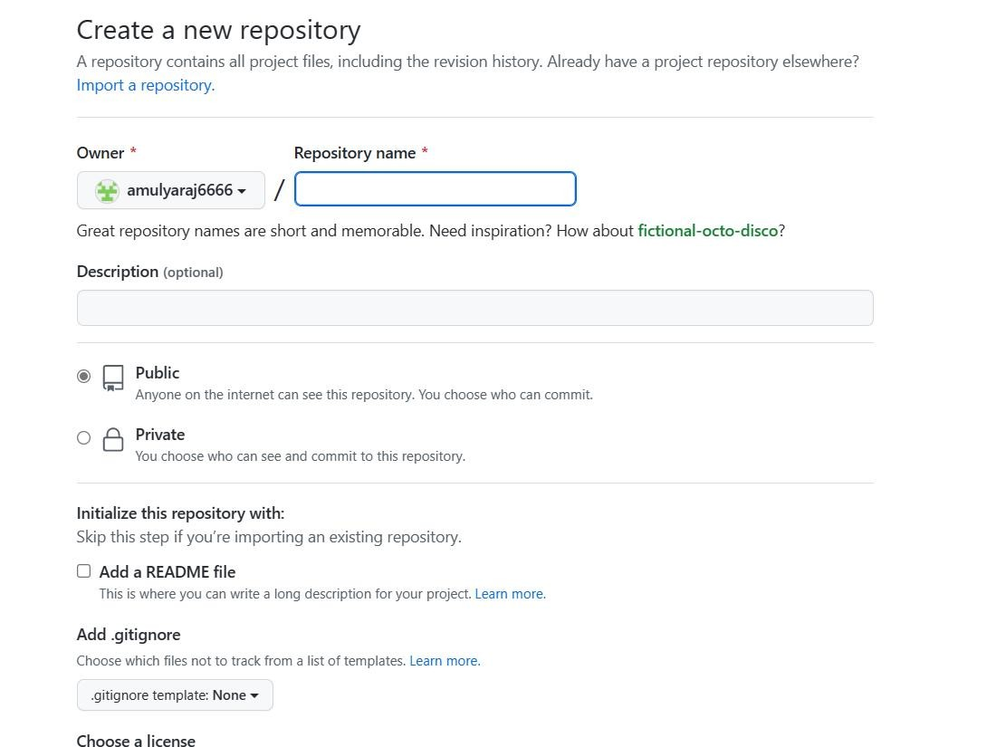
RESULT AND ANALYSIS
Snapshot : Creation of public files
Snapshot : Creation of private files
25 May 2023
DEPARTMENT OF COMPUTER SCIENCE AND ENGINEERING, A.I.T., CHIKKAMAGALURU.
13 March 2023

Slide 20
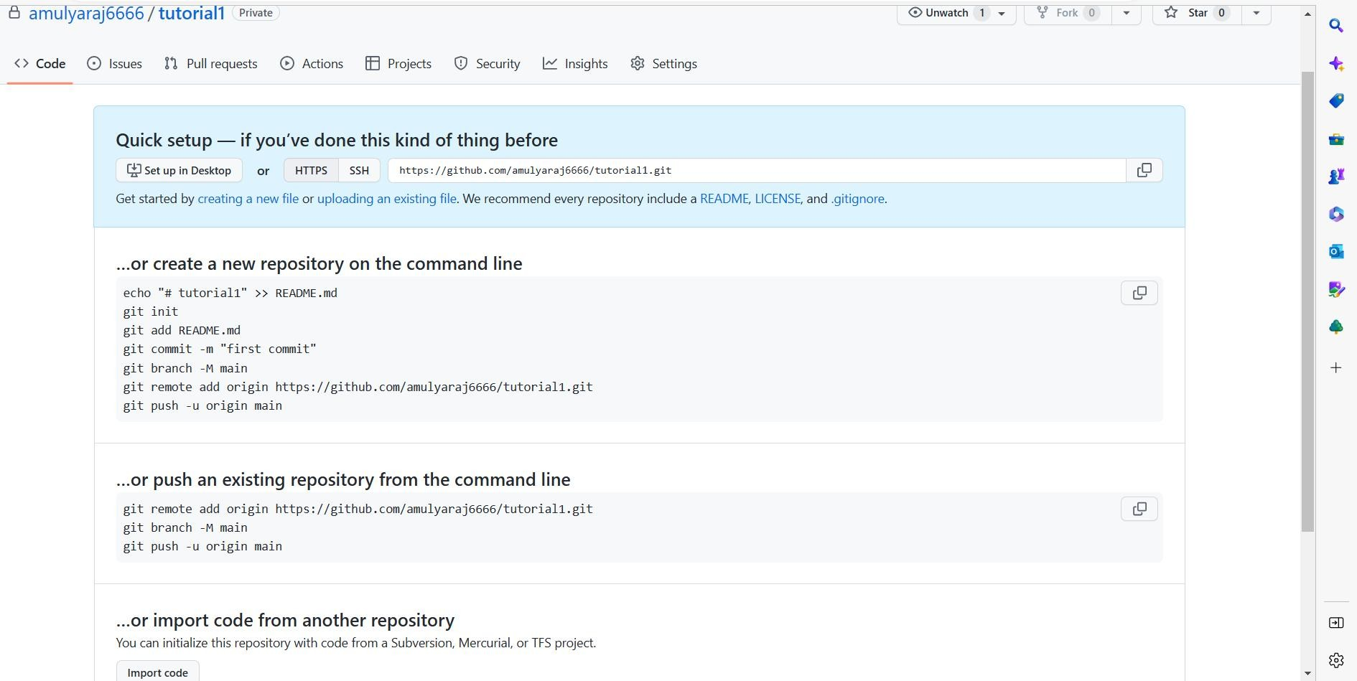
RESULT AND ANALYSIS
Snapshot 2: Uploading files to the repository
25 May 2023
DEPARTMENT OF COMPUTER SCIENCE AND ENGINEERING, A.I.T., CHIKKAMAGALURU.
13 March 2023

Slide 21
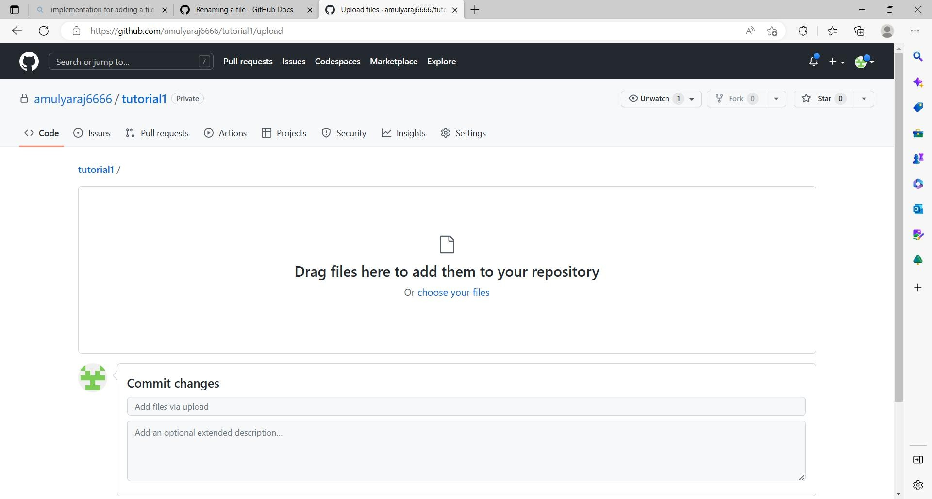
RESULT AND ANALYSIS
Snapshot 3: Drag and drop the file to upload
25 May 2023
DEPARTMENT OF COMPUTER SCIENCE AND ENGINEERING, A.I.T., CHIKKAMAGALURU.
13 March 2023

Slide 22
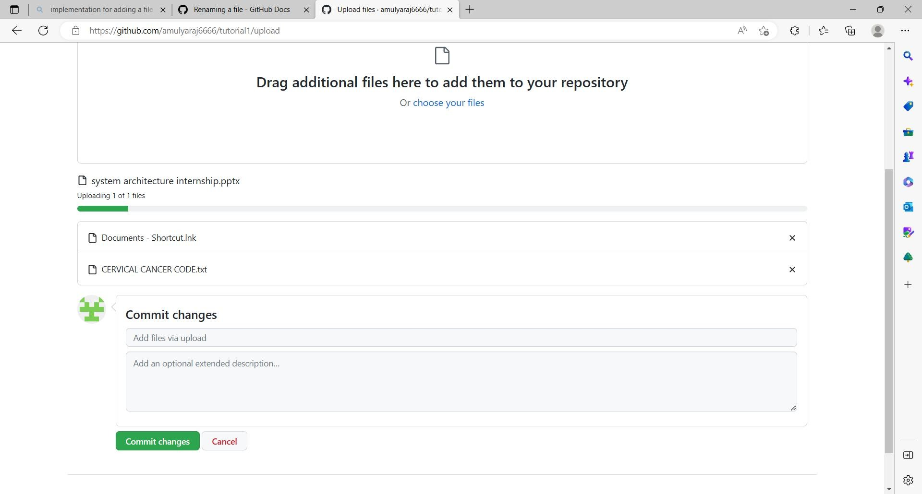
RESULT AND ANALYSIS
Snapshot 4:Files uploading to the repository
25 May 2023
DEPARTMENT OF COMPUTER SCIENCE AND ENGINEERING, A.I.T., CHIKKAMAGALURU.
13 March 2023

Slide 23
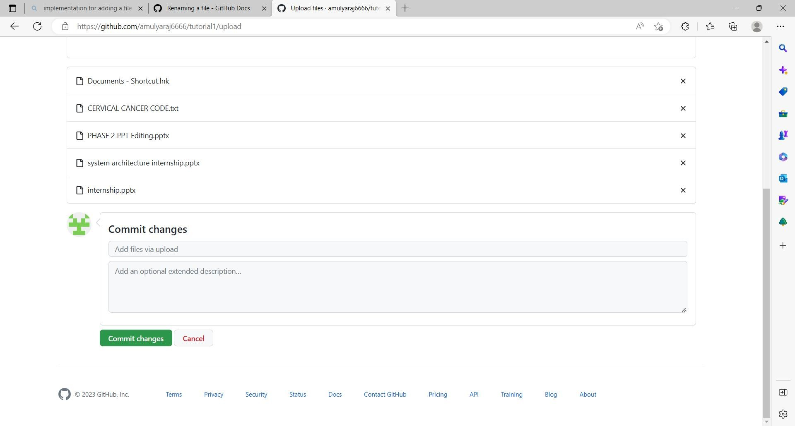
RESULT AND ANALYSIS
Snapshot : Commit changes after uploading file to the repository
25 May 2023
DEPARTMENT OF COMPUTER SCIENCE AND ENGINEERING, A.I.T., CHIKKAMAGALURU.
13 March 2023

Slide 24
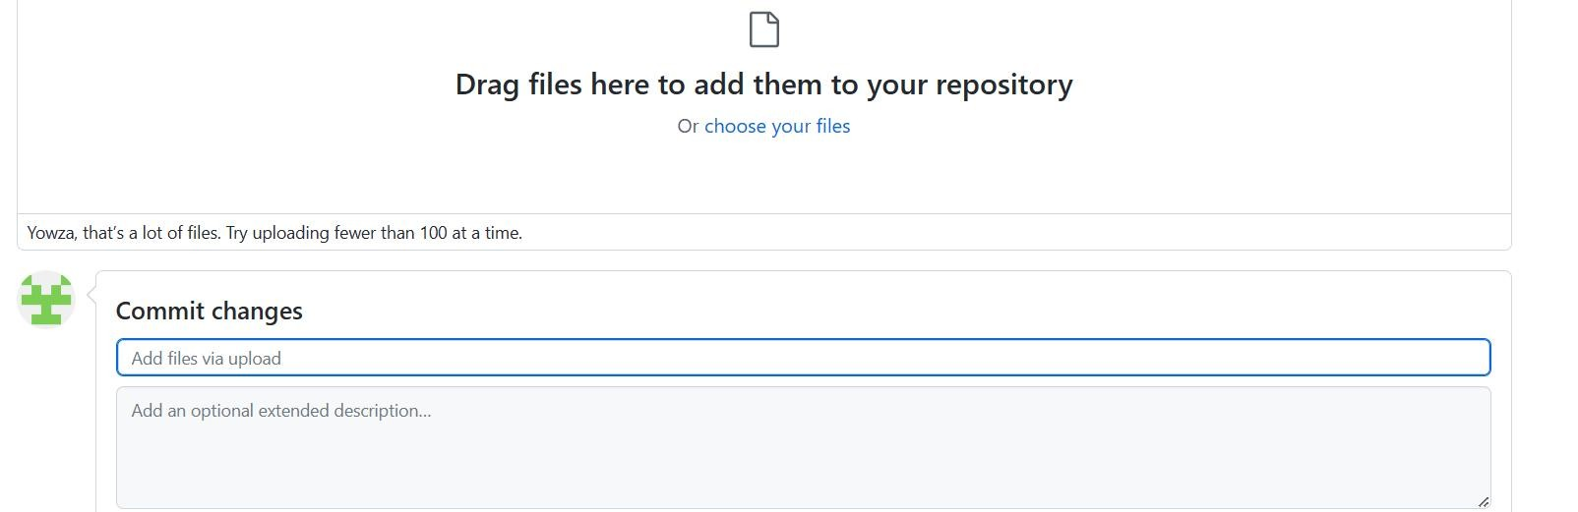
RESULT AND ANALYSIS
Snapshot 6: Error in uploading larger files and projects
DEPARTMENT OF COMPUTER SCIENCE AND ENGINEERING, A.I.T., CHIKKAMAGALURU.
25 May 2023

Slide 25
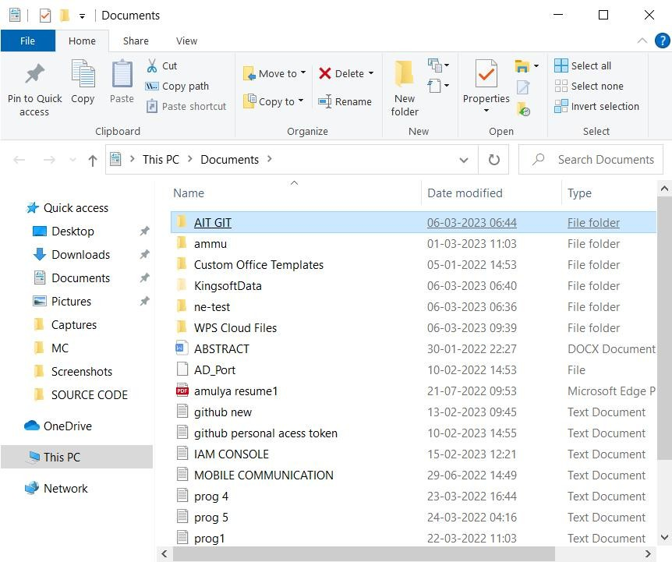
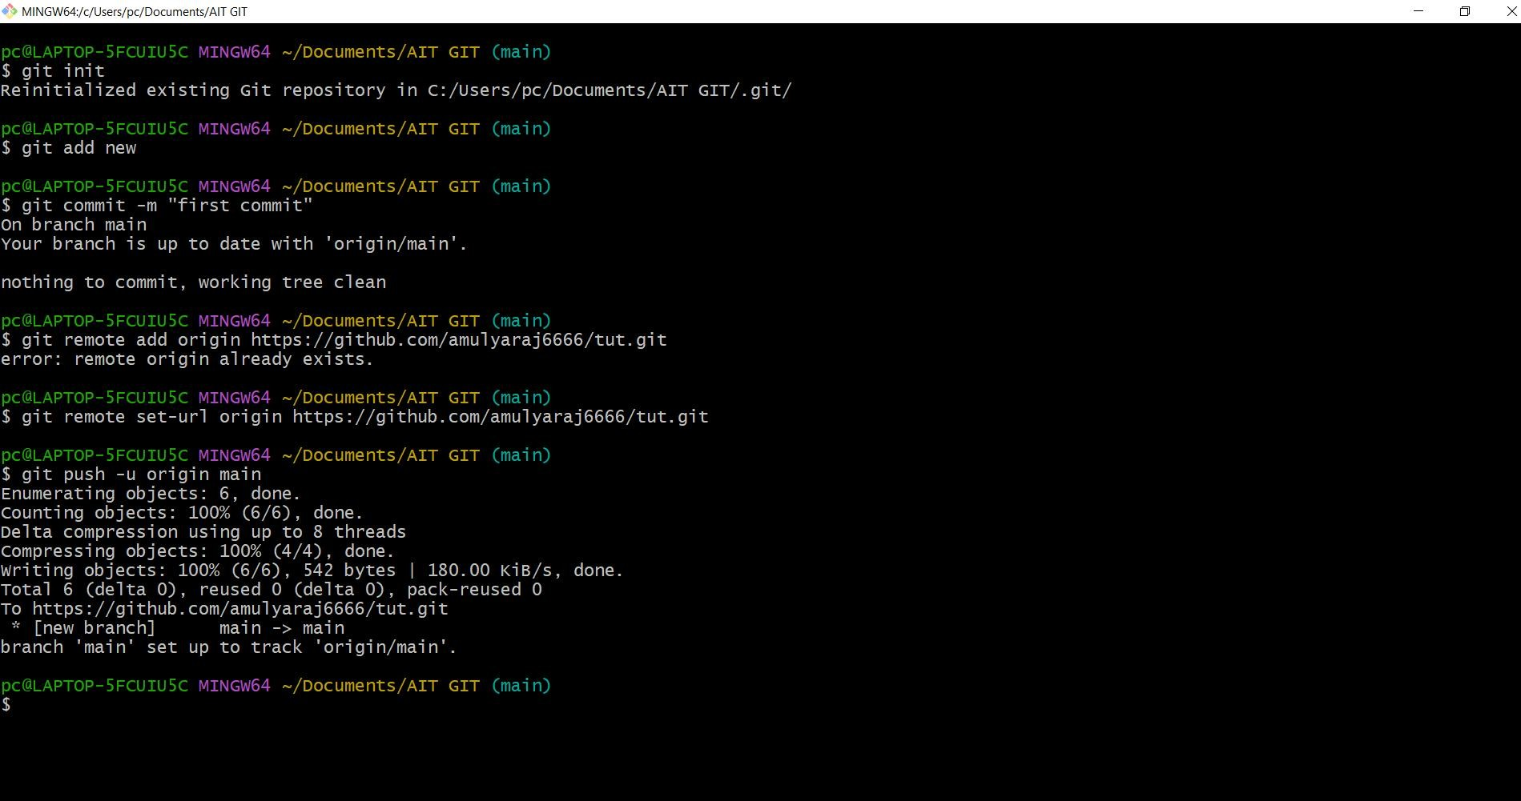
RESULT AND ANALYSIS
Snapshot : Selection of project and open gitbash
Snapshot : Debugging the error and uploading larger files using commands in Git Bash
25 May 2023
DEPARTMENT OF COMPUTER SCIENCE AND ENGINEERING, A.I.T., CHIKKAMAGALURU.
13 March 2023

Slide 26
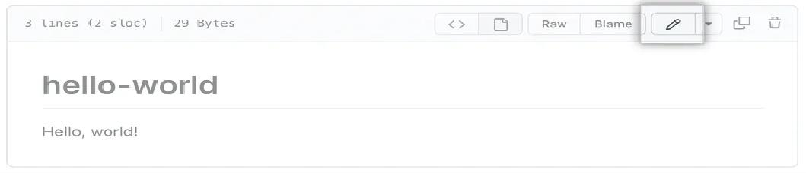
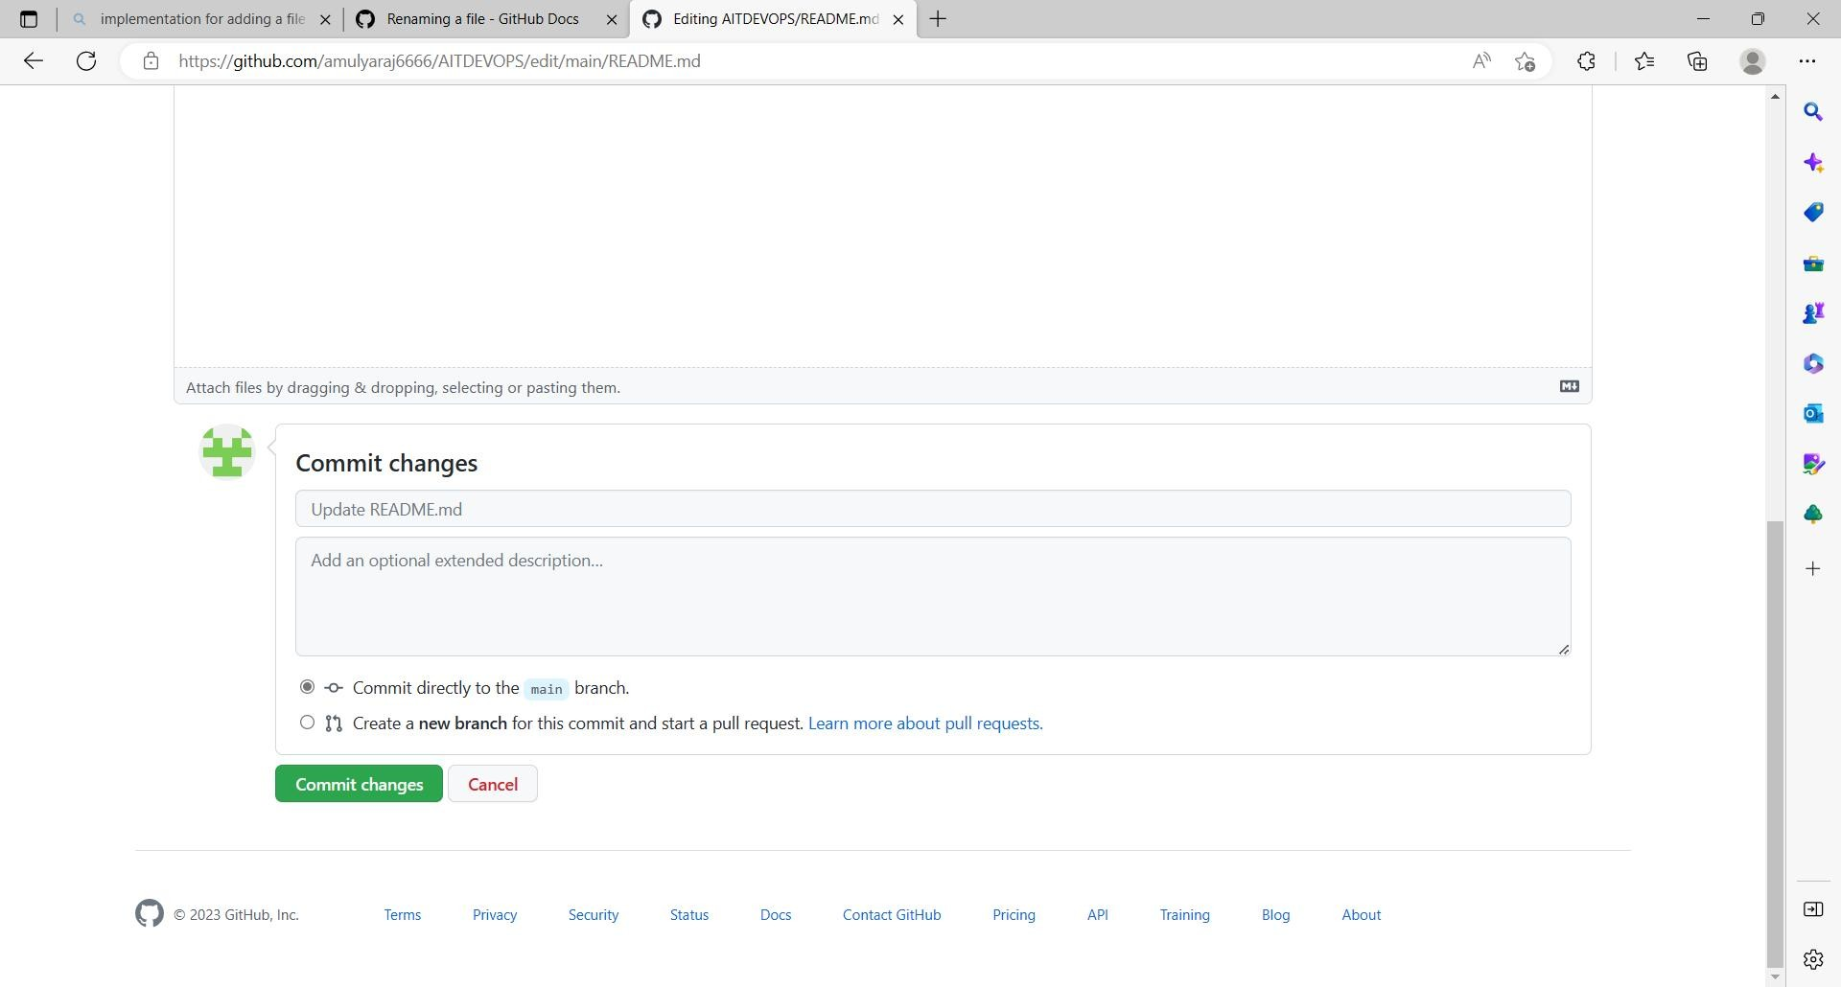
RESULT AND ANALYSIS
Snapshot 8: Editing content inside the file
Snapshot 9: Commit changes after editing the file
25 May 2023
DEPARTMENT OF COMPUTER SCIENCE AND ENGINEERING, A.I.T., CHIKKAMAGALURU.
13 March 2023

Slide 27

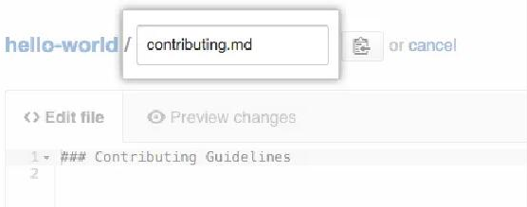
RESULT AND ANALYSIS
Snapshot 10: Renaming the file
Snapshot 11:Change the name of the file to the new filename
25 May 2023
DEPARTMENT OF COMPUTER SCIENCE AND ENGINEERING, A.I.T., CHIKKAMAGALURU.
13 March 2023

Slide 28
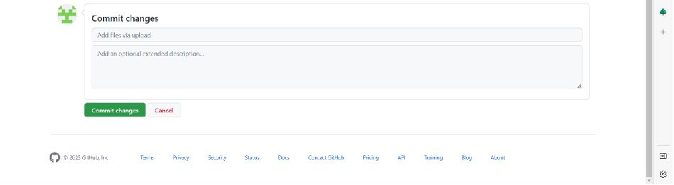
RESULT AND ANALYSIS
Snapshot 12: Commit chnages after renaming the file.
25 May 2023
DEPARTMENT OF COMPUTER SCIENCE AND ENGINEERING, A.I.T., CHIKKAMAGALURU.
13 March 2023

Slide 29
CONCLUSION AND FUTURE ENHANCEMENTS
Conclusion
Git and GitHub provides fast and convinient ways to track projects, wheather the projects is by one individual or a team of software developers.
GitHub has many complex features available, it’s easily accessible to individual and small projects need some kind of tracking mechanism,
In addition to version control, GitHub provides users with social platform for project management as well as the ability for users to create gists.
GitHub stores the sample code and exercise code from the lessons can be greate way to practice and gain experience with new software tool.
25 May 2023
DEPARTMENT OF COMPUTER SCIENCE AND ENGINEERING, A.I.T., CHIKKAMAGALURU.
13 March 2023

Slide 30
Future Enhancements
Allowing users to upload multiple files at once could save time and improve efficiency, especially when uploading a large number of files.
File type validation: Adding file type validation could prevent users from uploading files that are not supported or could cause issues. For example, validating that the file is a valid image, video, or audio file before allowing it to be uploaded.
Integration with cloud storage services: Integrating with popular cloud storage services like Dropbox or Google Drive could make it easier for users to upload files stored in these services.
Enhanced security measures: Improving security measures such as encryption, two-factor authentication, or virus scanning could help protect files uploaded to GitHub from unauthorized access or malware.
These are just a few possible enhancements that could be considered to improve the file uploading experience on GitHub. Ultimately, any enhancements should be carefully considered to ensure they align with the needs of users and the goals of the GitHub platform.
25 May 2023
DEPARTMENT OF COMPUTER SCIENCE AND ENGINEERING, A.I.T., CHIKKAMAGALURU.
13 March 2023

Slide 31
REFERENCES
E.Kalliamvakou, G. Gousios, K. Blincoe, L. Singer, D. M. German,and D. Damian, “An in-depth study of the promises and perils of miningGitHub,” Empirical Software Engineering, pp. 1–37, 2015.
G. Pinto, I. Steinmacher, and M. A. Gerosa, “More common than youthink: An in-depth study of casual contributors,” ser. SANER, 2016,pp. 112–123.
K. Yamashita, S. McIntosh, Y. Kamei, A. E. Hassan, and N. Ubayashi,“Revisiting the applicability of the pareto principle to core developmentteams in open source software projects,” ser. IWPSE, 2015, pp. 46–55.
G. Gousios, M. Pinzger, and A. v. Deursen, “An exploratory studyof the pull-based software development model,” ser. ICSE, 2014, pp.345–355.
G. Gousios, M.-A. Storey, and A. Bacchelli, “Work practices andchallenges in pull-based development: the contributor’s perspective,”ser. ICSE, 2016, pp. 285–296.
25 May 2023
DEPARTMENT OF COMPUTER SCIENCE AND ENGINEERING, A.I.T., CHIKKAMAGALURU.
30₁₃N_{M}ov_{a}e_{r}m_{ch}be₂r₀₂0₃21

Slide 32



